Slide 1
Teaching
with
A guide from

Slide 2
Ever find a video for your students that’s just right? Perfect even?
You show it to them (or they watch it on their own). It engages them. Makes them think. Starts really great conversations.
A video can be the right tool to kickstart great learning.
That’s why we created TEACHFLIX (teachflix.org). It’s a collection of videos – sorted into categories – that you can use with your students in class. We’ve found our own favorites – and curated suggestions from classroom teachers. It’s not a perfect, all-encompassing collection. But we like it. And we keep adding new videos to it!
Want to use it? And maximize your teaching with it?
This guide will help.
It includes several plug-and-play activities you can do with your students after watching almost any TEACHFLIX video. (Or almost any video you find on YouTube or other places, for that matter.)
Want to use them digitally? Click on the page you want to use. On a computer, go to File > Make a copy > Selected slides. Then share that copy with your students (through your learning management system or with a link). If you’re on a mobile device, click the three dots and choose “Share & Export,” then “Make a copy.”
Want a paper copy? Find the page in this guide you want to use. Adjust the text (or anything else) and delete out anything you don’t want on your print out. Then go to File > Print and under Pages, choose “Custom” and only select the pages you want.
If you love all of these TEACHFLIX resources, you should check out all we have for you at Ditch That Textbook! It’s full of free teacher resources, including teaching ideas, templates, tech tools, and more.
Scroll down the homepage to the “Explore the DTT blog” as a good starting point. Or choose “Templates” from the resources section in the top right.
All of this stuff might help you write your lesson plans for the next few days … or more! That’s our hope anyway!

Slide 3
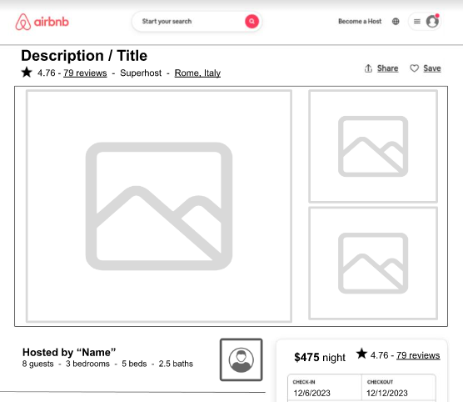
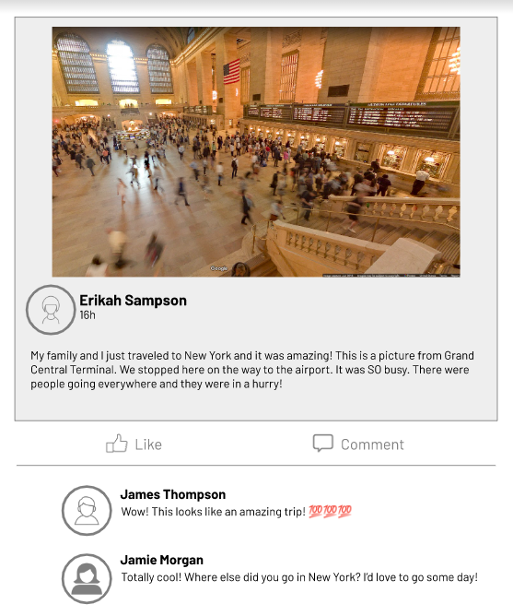
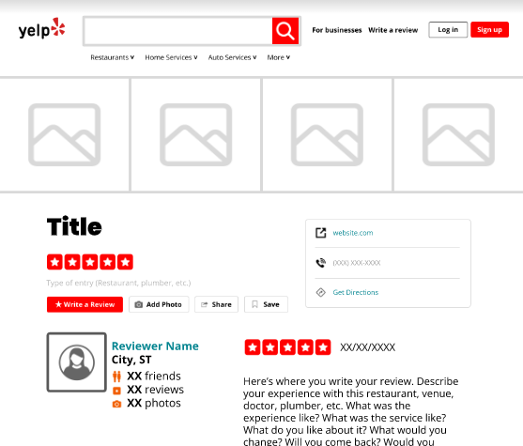
Make it social
Our social media templates for Slides and PowerPoint make learning feel like apps students love. Here are a few ideas you can use.
Watching a video about a place? Have students create an Airbnb listing about it to show what they’ve learned. Template
Facebook-style social posts let students write as themselves (or as a character) to demonstrate learning. Template
More templates like these:
DitchThat Textbook.com/ templates
Write a Yelp review about a service or business. Template

Slide 4
Riddle me this...
Use this worksheet along with any of the math riddle videos in TEACHFLIX. Watch the video and remember to pause before they share the solution!
Rewrite or summarize the key information in the riddle.
Draw or sketch out your thinking (Use the back of this page or another paper if you need it).
Write your answer below.

Slide 5
Word splash
Watch the video and write down 12 important words. After the video swap your page with a partner. Watch the video again and listen for the words they chose. Cross them out as you hear them.

Slide 6
Tweet all about it!
Write a summary of the video below. Then create a tweet using 280 characters or less to highlight the video and share with others.

Slide 7
Brain Dump
Watch the video. Then after it’s over take two minutes to write down everything you remember from it.

Slide 8
3-2-1 Protocol
Use this worksheet along with any of the videos in TEACHFLIX.
Watch the video and then share your responses below.
Write down three things you learned or
three takeaways from the video.
Jot down two questions you still have.
Describe one thing you liked about the video.

Slide 9
4 Step Summary
Watch the video. Then summarize what you learned in just 4 steps.
1
2
3
4

Slide 10
Quiz Maker
Watch any TEACHFLIX video then create a multiple choice question for the concept we just learned about. You need to have the question along with three incorrect answers and one correct answer. Teachers: Using the questions the students wrote, create a class Kahoot to play the next day.
Write your quiz question below.
Create your multiple choice answers. Write three incorrect answers and one correct answer.

Slide 11
Picture Dictionary
Watch the video and identify key words. Create a sketch or find an image of each word to define it. You can create a bilingual dictionary after watching a world language video by adding the English word along with the picture.
Text here
Text here
Text here
Text here
Text here
Text here

Slide 12
Hexagonal Thinking
While watching the video identify 5 key terms or phrases and write each one down inside a hexagon.
After you’re finished cut out your hexagons. With a group combine your hexagons and make connections between terms by placing them next to one another creating a web.
Write down your thinking about at least two connections you made.

Slide 13
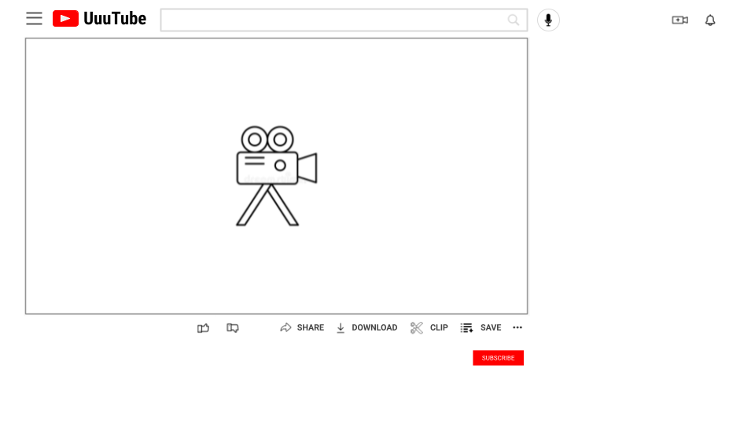
YouTube Channel
Have students create their own YouTube Channel page. They can create and upload their own video and suggest real or fictional related videos. Open this template in Google Slides or PowerPoint and create a copy for your class. The directions below are also embedded in the template.
Search
Name of alternate video
Name of originator
256 views - 2 days ago
New
Name of alternate video
Name of originator
256 views - 2 days ago
New
Name of alternate video
Name of originator
256 views - 2 days ago
New
Name of alternate video
Name of originator
256 views - 2 days ago
New
Name of alternate video
Name of originator
256 views - 2 days ago
New
Title of Your Video
1,234 views - May 9, 2022
256
2
Name of alternate video
Name of originator
256 views - 2 days ago
New
Name of Originator
123 subscribers
Description of your video…
How to use this template:
1. Text
You can change the search, title, views & date, likes & dislikes, originator & subscribers & description, and other video info at the right . Just highlight the text you want to change and start typing. (Note: If you delete all of the text and start typing, you might lose the formatting, like color and boldness.)
2. Images
You can change any of the six images at the right, and the originator profile photo. Click the image and click “Replace image” in the menu bar at the top to select a different image.
3. Video
Create a horizontal video using a cell phone/tablet with a camera app or Flipgrid. Upload the video to Google Drive and insert it in this template. “Insert” - “Video” - “Google Drive” - highlight your video - “Select” Center your video in the video box on the template.
When you’re done …
This template is intended to be done digitally. Do all of the work in edit mode. There’s no need to hit the “Present” button.
This template was made by Ditch That Textbook, a resource for creative teaching ideas for teachers. Find more FREE templates like this at DitchThatTextbook.com/templates.

Slide 14
Storyboard
Have students create a storyboard that summarizes the video. Open this template in Google Slides or PowerPoint.and create a copy for your class. The directions below are embedded in the template.
STORYBOARD by Your Name
Optional Description Line…
Story Line…
Story Line…
Story Line…
Story Line…
Story Line…
Story Line…
How to use this template:
1. Text
You can change the STORYBOARD title with your name, Description line, and the Story Lines under each image. (Each Storyline can
hold 5 lines of text) Just highlight the text you want to change and start typing. (Note: If you delete all of the text and start typing, you might lose the formatting, like color and boldness.)
2. Images
You can change any of the six images. Click the image and click “Replace image” in the menu bar at the top to select a different image.
The TEACHFLIX logo is not in the background, it can be replaced or deleted.
3. How to take a Screenshot
Try out this web site on how to do a Screenshot with Android, iOS, iPadOS, Windows, Mac, Chrome OS and Linux at:
https://www.take-a-screenshot.org/
Upload the Screenshot to your Google Drive and “Replace Image” in this template.

Slide 15
Send a Postcard
After visiting one of the locations in the Virtual Field Trips section of TeachFlix design a postcard to share what you learned. Who would you send it to? What would you tell them about the experience?
Greetings from

Slide 16
Movie Poster
Design a movie poster to go along with the video. If this movie was being shown at the theater what would you highlight to get people to watch? Try to include a catchy quote or tagline to draw people in.

Slide 17
Pssst! Passing Notes
Yes, in this activity you get to pass notes! The catch? You have to turn these in to your teacher. Choose a partner. During the video write a note to your partner about what you watched. Pass them the note. Have your partner respond to your note and pass it back. Keep passing notes throughout the video.

Slide 18
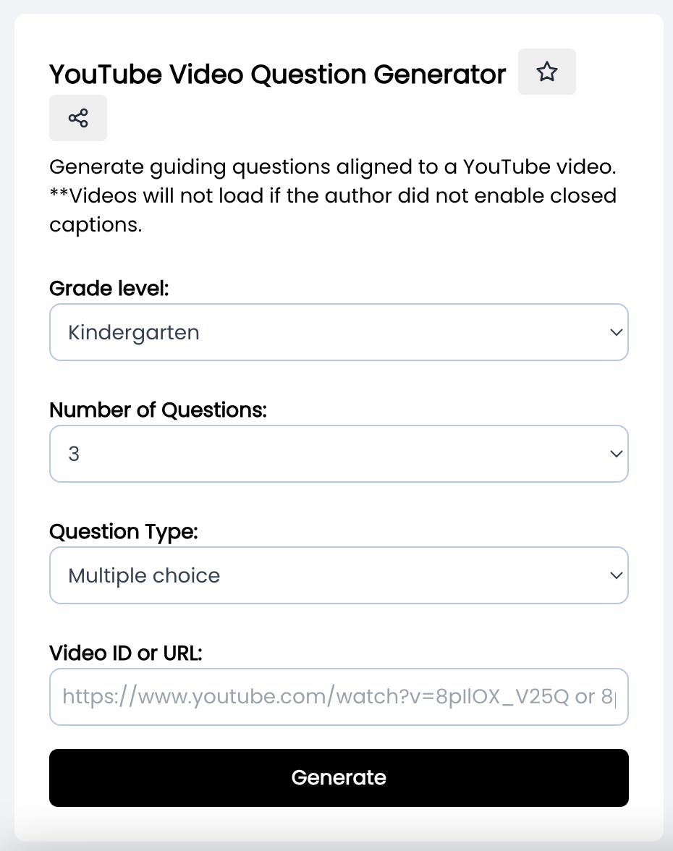
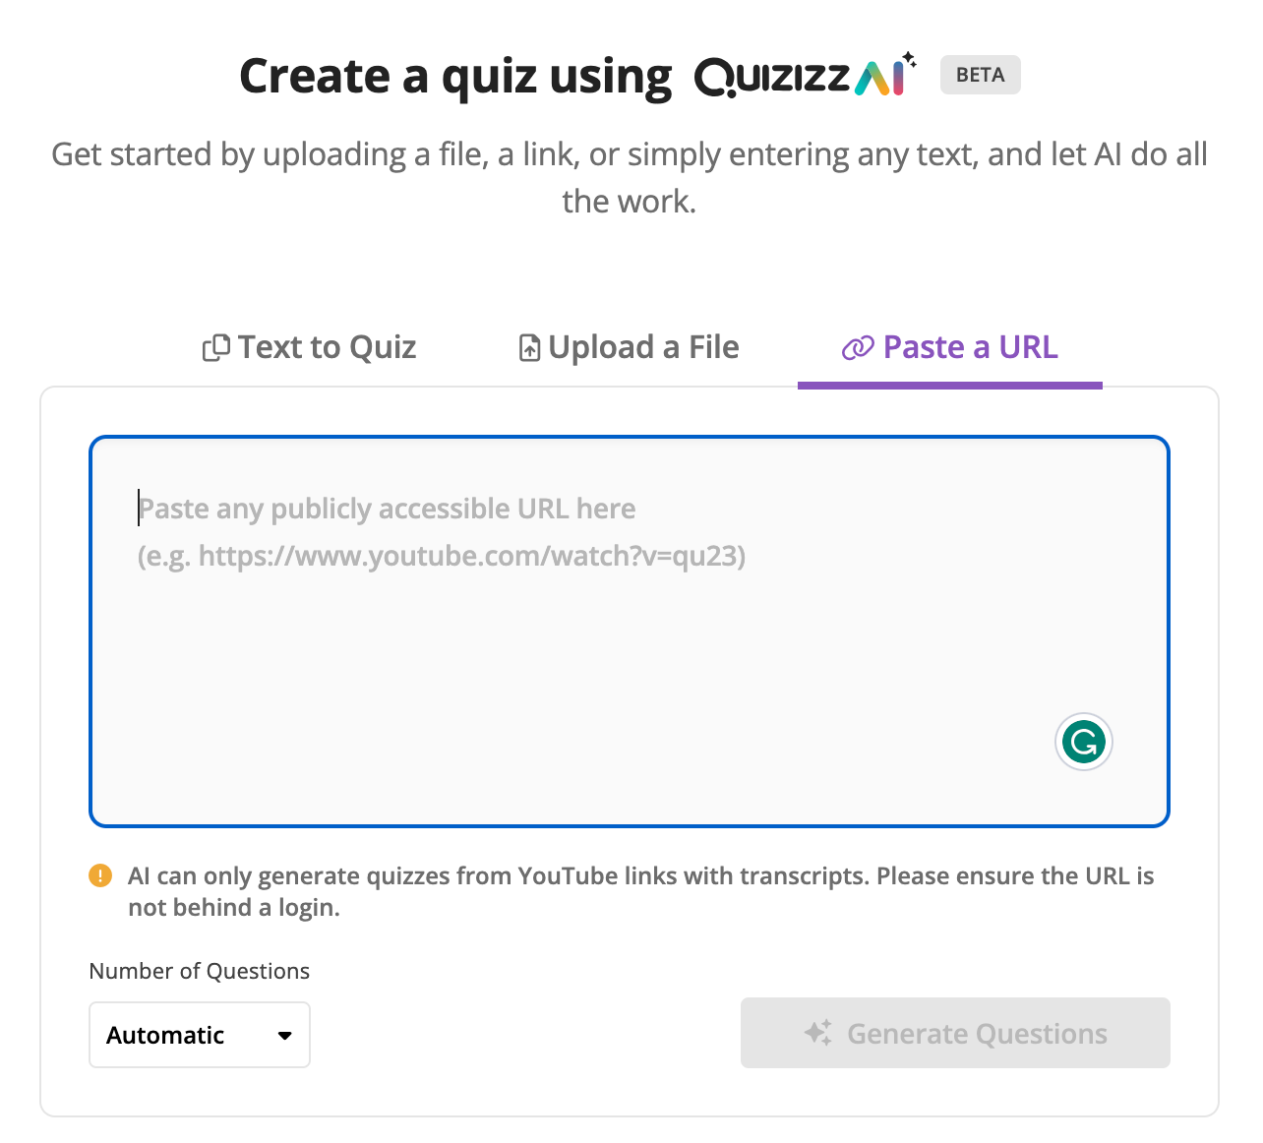
AI & TEACHFLIX
Combine the power of Artificial Intelligence and TEACHFLIX to generate a quiz or discussion questions from any video* on TEACHFLIX!
With MagicSchool.ai’s YouTube Video Question Generator you can choose the grade level, number of questions and question types.
*Only videos with closed captions
enabled can be loaded.
Quizizz AI allows you to create a quiz by uploading a file, a link, or simply entering any text. Just paste it in and sit back and let AI do all the work!
Learn more about AI at ditchthattextbook.com/ai-edu

Slide 19
Find MORE Great Videos
If you can’t find exactly what you’re looking for at Teachflix.org, here’s how you can find more on your own:
Click on the profile picture. When you find a video you really like, click the profile picture and search within that creator’s YouTube channel for more.
Create your own playlist. TEACHFLIX doesn’t have everything! Create a YouTube playlist, and when you find a video you love, add the video to it.
Save playlists. If you find a playlist you really like – or someone shares one with you – you can save other people’s playlists to your YouTube library.
Share playlists with students. What do you do with those playlists? When you need them, grab a link and share them with students. Here’s how.
Create your own TEACHFLIX. Well, something kind of like it! Create a Google Site and embed your favorite videos on it. Then share with students.

Slide 20
Find MORE Great Videos
Here are some our favorite YouTube channels to check out with even MORE great videos to teach with! Just click on the image for a link, head over and hit subscribe.
In the book, Tech Like a Pirate, video is just one of the seven ways to boost student engagement. You'll find even more practical ideas to make learning meaningful and fun with video in the book. Check it out!
Order on Amazon

